Slide 1
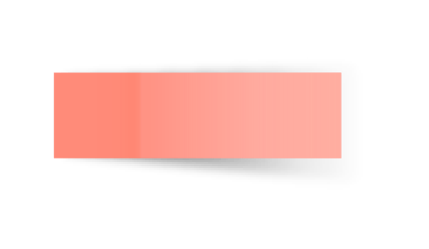
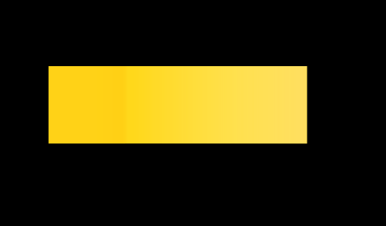
Programming Concepts: Functions
Here starts the lesson!

Slide 2

Table of Contents!
Functions
How they work?
Example
Why Function?
What are they?
The underlying procedure
Let’s see a demo
Their importance

Slide 3

01
What are Functions?

Slide 4

Have you ever faced this problem?
Writing the same code again and again in a program.
Do you not feel it a waste of time and effort?
If your answer is a YES, then let us see how FUNCTIONS will solve this for you.

Slide 5

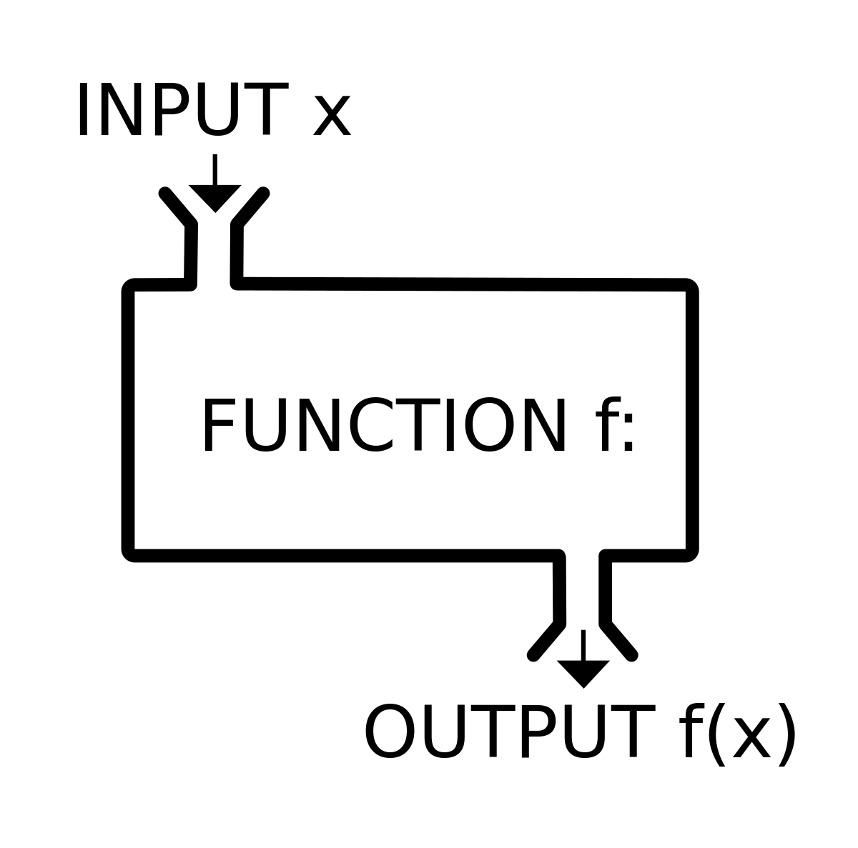
What are Functions?
A function is a group of related statements that performs a specific task.
We can break our program into smaller and modular chunks.
We can avoid repetition and makes our code reusable.

Slide 6
Writing Functions
Sample
function name
Let’s understand the syntax:
To define, we use the def keyword, along with the function name.
A function accepts the parameter.
The function block starts with colon, and statements must be indented.
At the end, we have a return keyword to send the value back.
def calculateArea(l, b):
area = l * b
return area
keyword
parameters
return statement

Slide 7
That was somewhat technical in nature - Let us break it down and look at a simple demonstration

Slide 8
Structure:
‘l and b’ written in () are the function parameters. They are types of information that we can provide to a function. A function can have multiple arguments and can be of any data type.
Note that statements inside function are indented as per Python syntax.
The return at the end will mark the end of function and transfer the output to the calling block.
def calculateArea(l, b):
area = l * b
return area
A function always starts with the def keyword which gives an idea to the interpreter that whatever is written after the def is a function.
‘calculateArea’ is unique name given by the user to the function for easy reference.

Slide 9
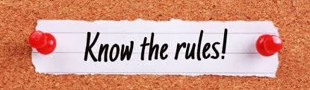
A function must be defined before it is used or called.
To call the function, we write the function name followed by ().
A function can have 0 to multiple arguments.
If no return statement is present the function will return ‘None’.

Slide 10
02
Example

Slide 11
Demonstration
Let us say we want to add 2 values and find its result. We define the function ‘addValues’ as below:
def addValues(value1, value2):
result = value1 + value2
return result

Slide 12
How do we use the function defined?
In Python, after the function is defined, we can call it using another function. (calling function)
# function definition
def my_function():
print("We are learning Functions")
# function calling
my_function() —> calling the ‘my_function()’

Slide 13
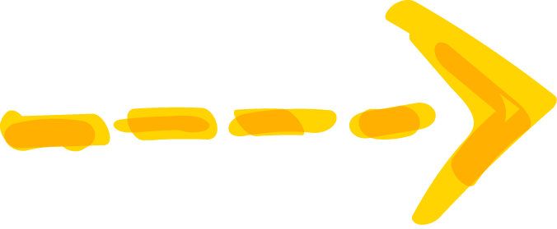
Till now we have seen theory about functions. Let us see how they work internally.

Slide 14
03
How they work?

Slide 15
Working
The first function whenever a program is executed is the ‘main’ function.
The Python interpreter executes the instructions in the main() sequentially. So the variable A has value 2 and B has 3. Currently the control is still in the main() only.
Once the 3rd instruction is encountered main() does not have the answer from addValues(). Since it is defined before main(), the control now goes to addValues(). The result is computed and value is returned back to main().
We have 2 functions - the calling function and the called function as follows:
# Called function
def addValues(value1, value2):
result = value1 + value2
return result
# Calling function
if __name__ == “__main__”:
A = 2
B = 3
sum = addValues(A, B)
print(sum)

Slide 16
Internal working
Program Control
# Calling function
if __name__ == “__main__”:
A = 2
B = 3
sum = addValues(2, 3)
# Called function
def addValues(2, 3):
value1 = 2
print(sum)
value2 = 3
result = 2 + 3 = 5
FINAL OUTPUT: 5
return result (5)

Slide 17
Now, that we have learnt what functions, examples, and their working we can now see why they are so much preferred.

Slide 18
04
Why functions?

Slide 19
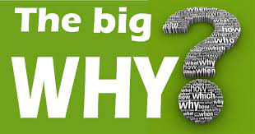
Their Importance
The first reason is reusability. Once a function is defined, you can invoke the same function many times in your program, which saves you work.
Once reusable, we can avoid code repetition and save effort and time.
We can break our program into smaller and modular chunks. So, when our program grows larger and larger, functions help us to make it more organized and manageable.

Slide 20
Review of Concepts
We have looked at functions - what they are.
We understood the underlying working principle.
We saw how functions are defined.
We demonstrated the function call and the execution.
We acknowledged the advantages of using functions.

Slide 21
Additional Resources
Python Basics: A Practical Introduction to Python3
Python 3 for Absolute Beginners

Slide 22
So to conclude, I would encourage everyone to study in-depth about functions and definitely use them in everyday programming to make coding easier.

Slide 23
THANKS !

